Slide 1
Air Pollution Monitoring in Cities
Dr. Mohanasundaram SV
CDAC Bangalore
mohansv@cdac.in

Slide 2
National ambient air quality standards
Pollutant | Satisfactory level* | Time weighted average
Sulphur dioxide (SO₂) | 80 µg/m³ | 24 hrs
Nitrogen dioxide (NO₂) | 80 µg/m³ | 24 hrs
Ozone (O₃) | 100 µg/m³ | 8 hrs
Carbon Monoxide (CO) | 2 mg/m³ | 8 hrs
Ammonia (NH₃) | 400 µg/m³ | 24 hrs
Lead (Pb) | 1 µg/m³ | 24 hrs
PM2.5 | 60 µg/m³ | 24 hrs
PM10 | 100 µg/m³ | 24 hrs
Benzene (C₆H₆) | 5 µg/m³ | Annual
Benzo Pyrene | 1 ng/m³ | Annual
Arsenic (As) | 6 ng/m³ | Annual
Nickel (Ni) | 20 ng/m³ | Annual
*Must comply at least 98% of the time

Slide 3
Air pollutants and their concentrations in ppm and severity levels as per CPCB, India
What pollutants we target?
Severity level | NO₂ (in ppm) | SO₂ (in ppm) | NH₃ (in ppm) | CO (in ppm) | O₃ (in ppm)
Good | 0.021 | 0.015 | 0.287 | 0.873 | 0.025
Satisfactory | 0.043 | 0.031 | 0.574 | 1.746 | 0.051
Moderate | 0.096 | 0.145 | 1.149 | 8.729 | 0.086
Poor | 0.149 | 0.305 | 1.723 | 14.840 | 0.106
Very Poor | 0.213 | 0.437 | 2.584 | 29.679 | 0.381
Severe | > 0.213 | > 0.437 | > 2.584 | > 29.679 | > 0.381

Slide 4
Air pollution station
Controller,
Communication
and interfaces
Sensors
Auto Calibration
and cross sensitivity
Elimination
Air
Sample
In
Air
Out
Area code | Category of area
A | Industrial area
B | Commercial area
C | Residential area
D | Silence Zone

Slide 5
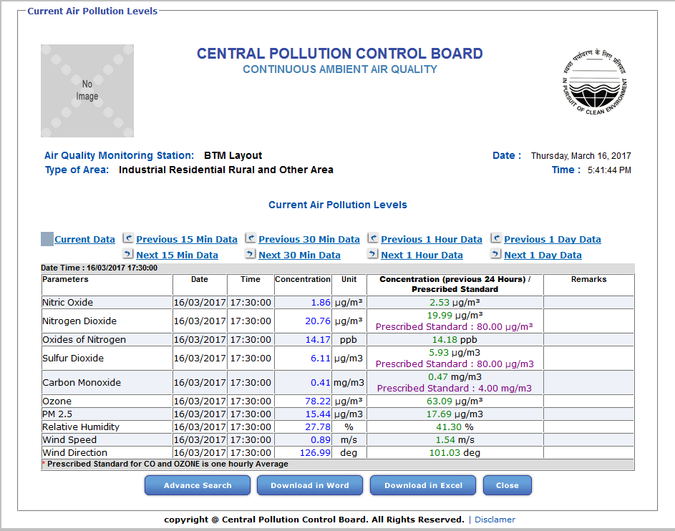

Slide 6
AIR QUALITY DASHBOARD

Slide 7
AIR QUALITY NETWORK

Slide 8
NODE CONFIGURATION

Slide 9
Nodes Display – SITE ENGINEER

Slide 10
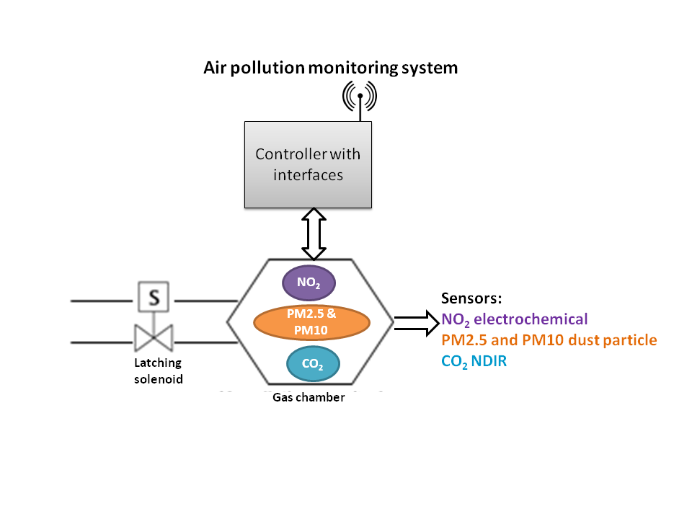
Air pollution – Alerting Mechanism
Alert for NO₂ and Dust particles
Alert on Click of a Button
Threshold detection:
If Average of NO₂ value for a day (24 hours) exceeds the Severity level of satisfactory ie., > 0.043 then trigger an alert of SMS, E-mail and RED alert on Dashboard.
Dust Particles (Particulate Matter):
Average of that Day:
PM 2.5 – 60 µg/m³
PM 10 – 100 µg/m³

Slide 11
THANK YOU

